Slide 1
Smart Parking System
OBJECTIVES
The main aim of this project is reduces the risk of finding the parking slots in any parking area. It eliminates the unnecessary travelling of vehicles across the filled parking slots in a city.

Slide 2
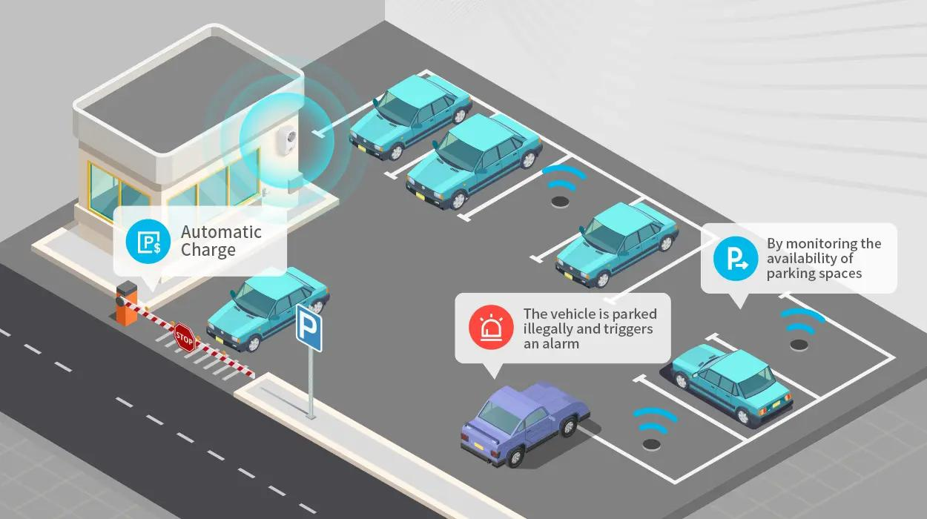
What is smart parking system
Smart parking system is an integrated system to organize cars in public parks. The system will be used for every slot in park. The motivation of this project is to help drivers. And make the payment way easier.

Slide 3

How does smart parking work?
Here are the essential pieces needed to make smart parking work: A sensor Communication to the driver A dashboard

